Slide 1



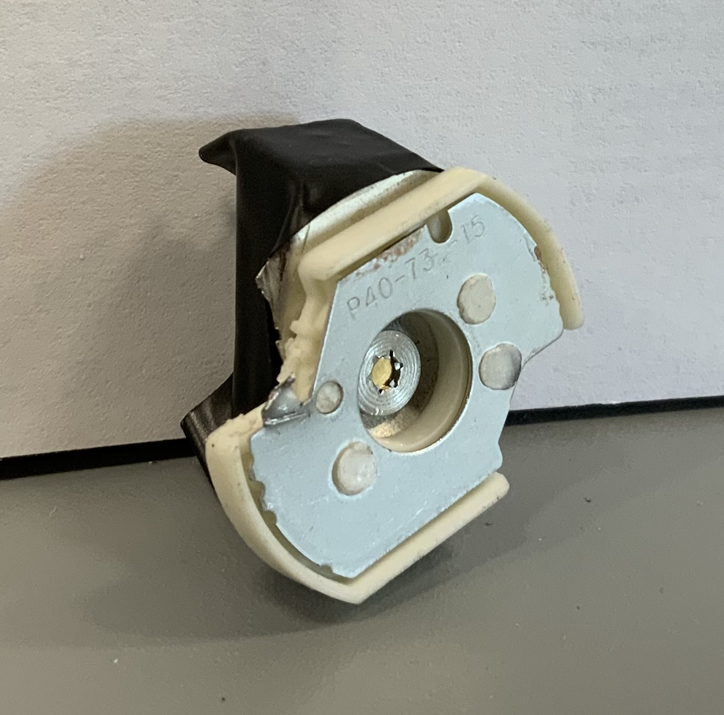
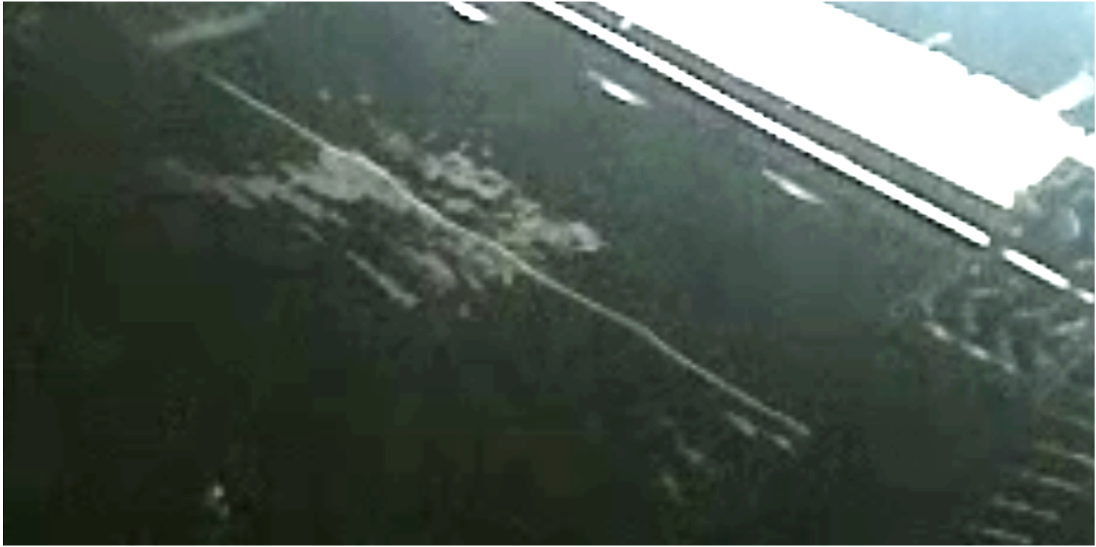
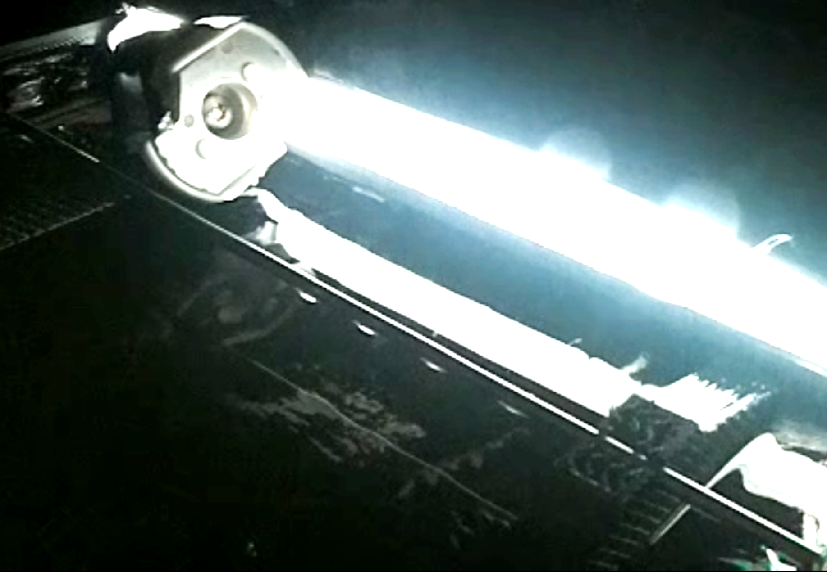
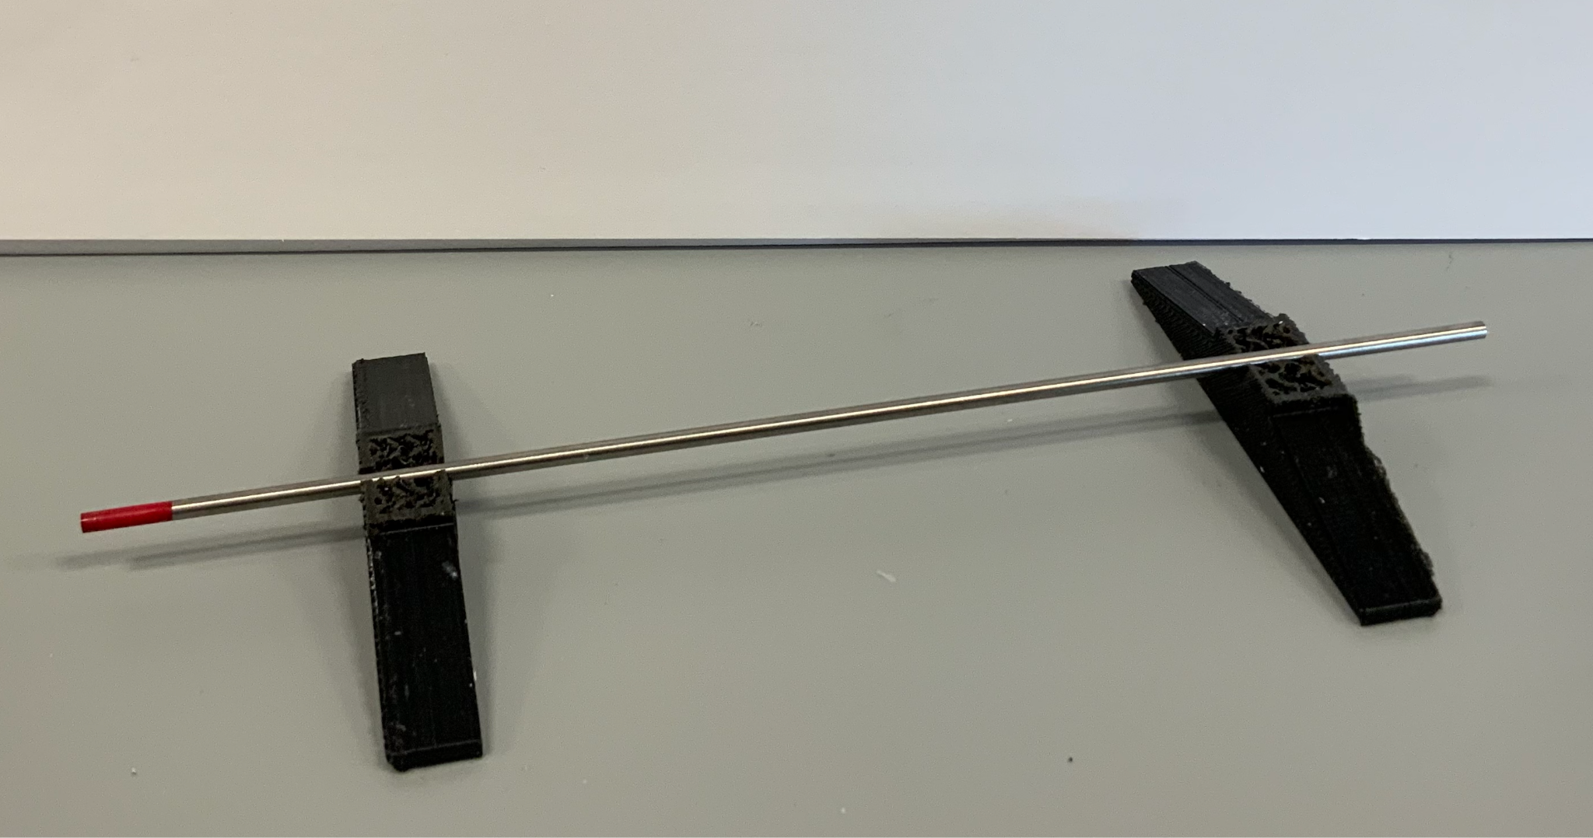
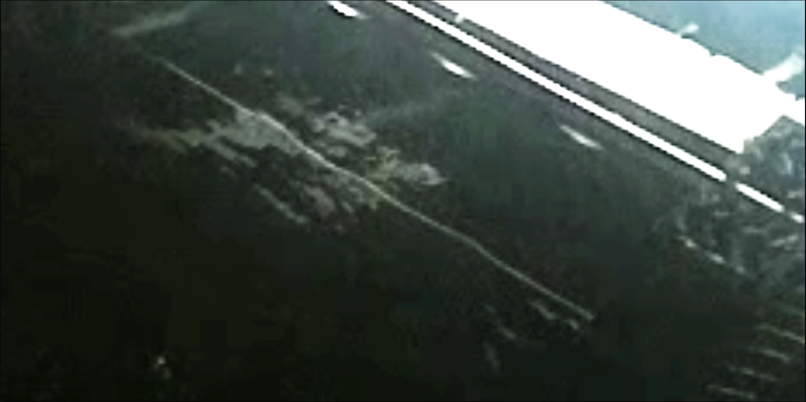
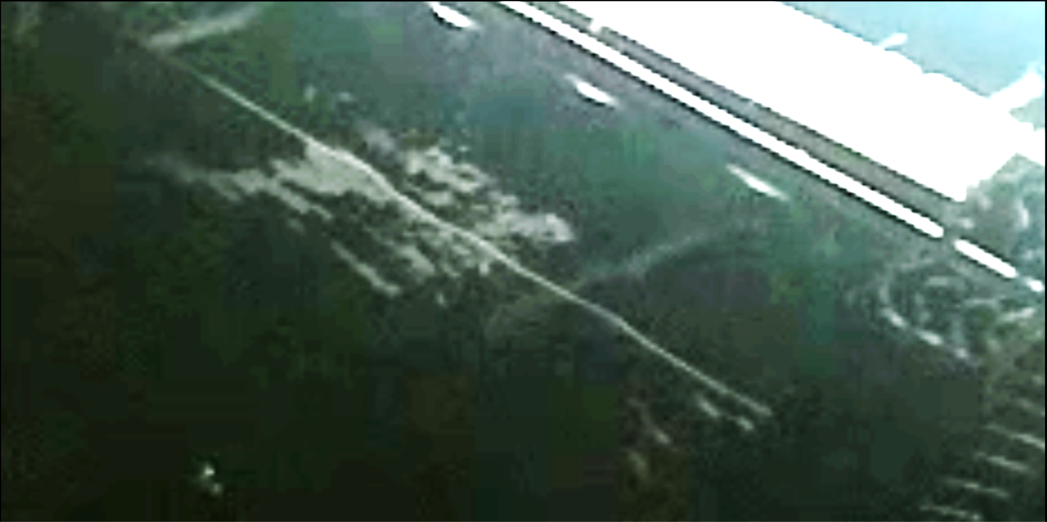
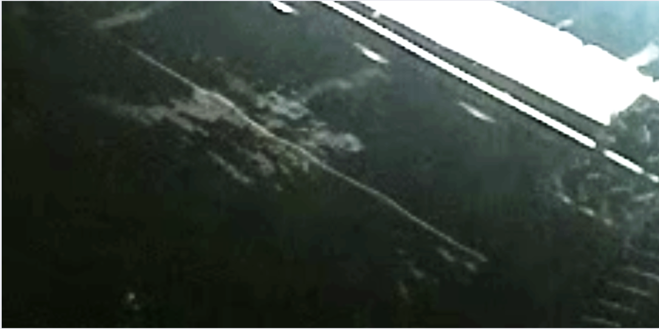
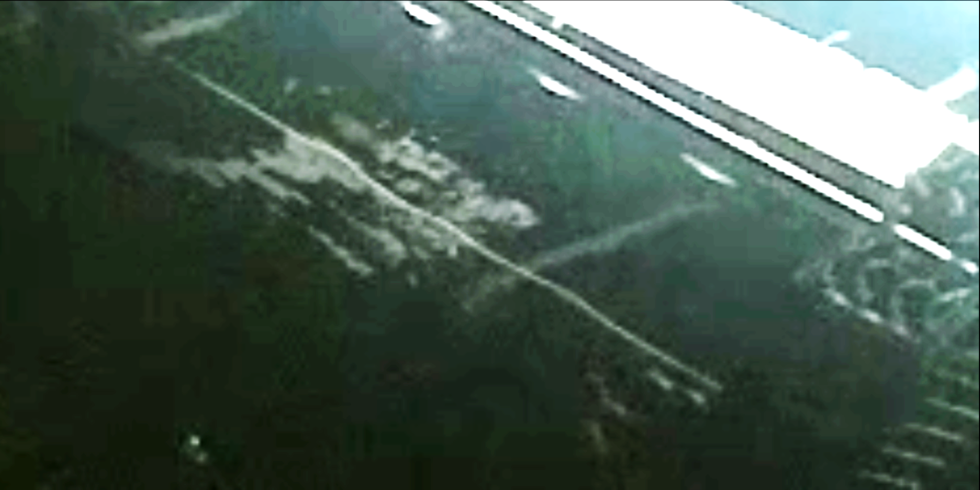
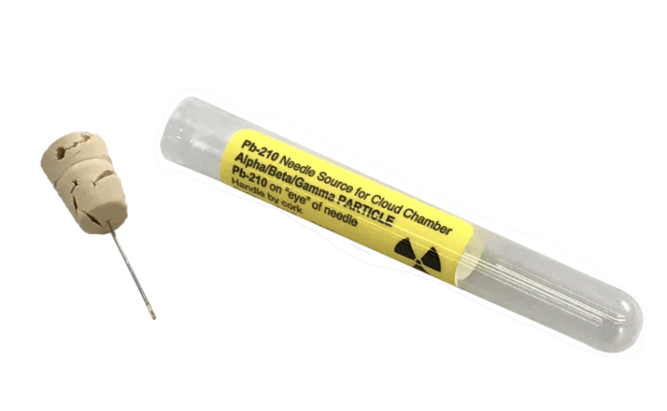
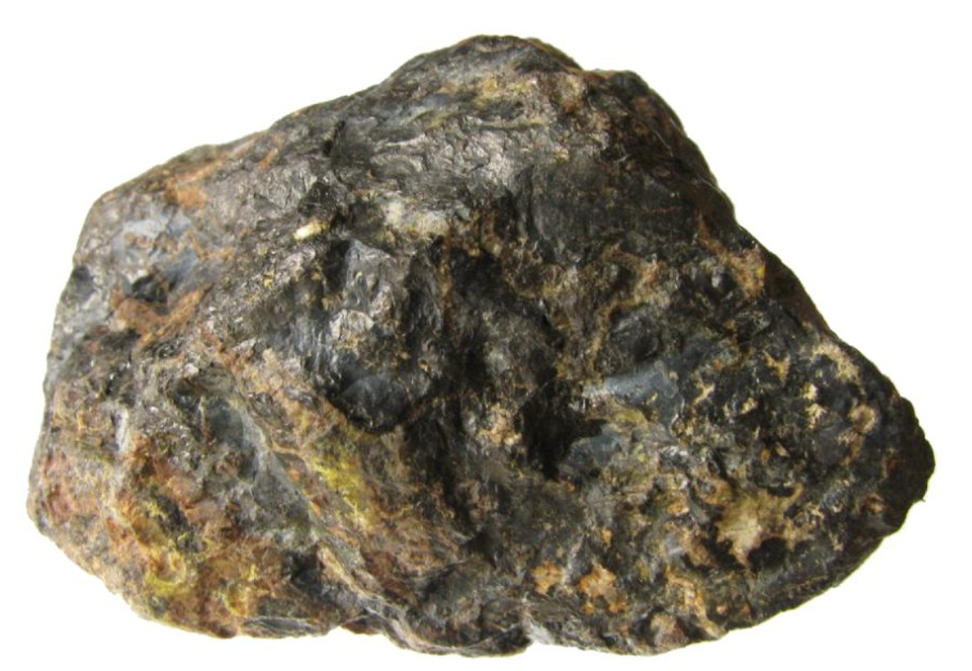
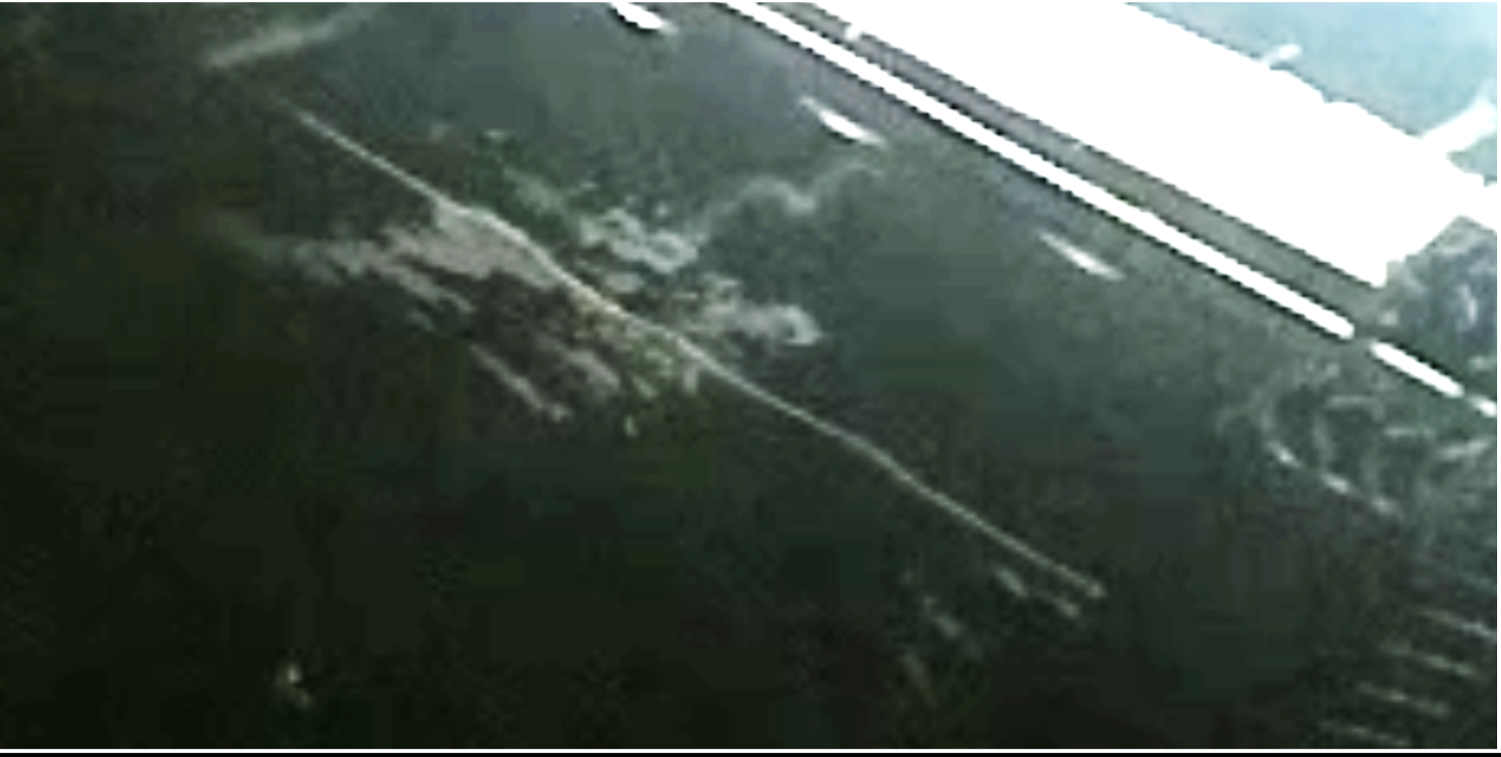
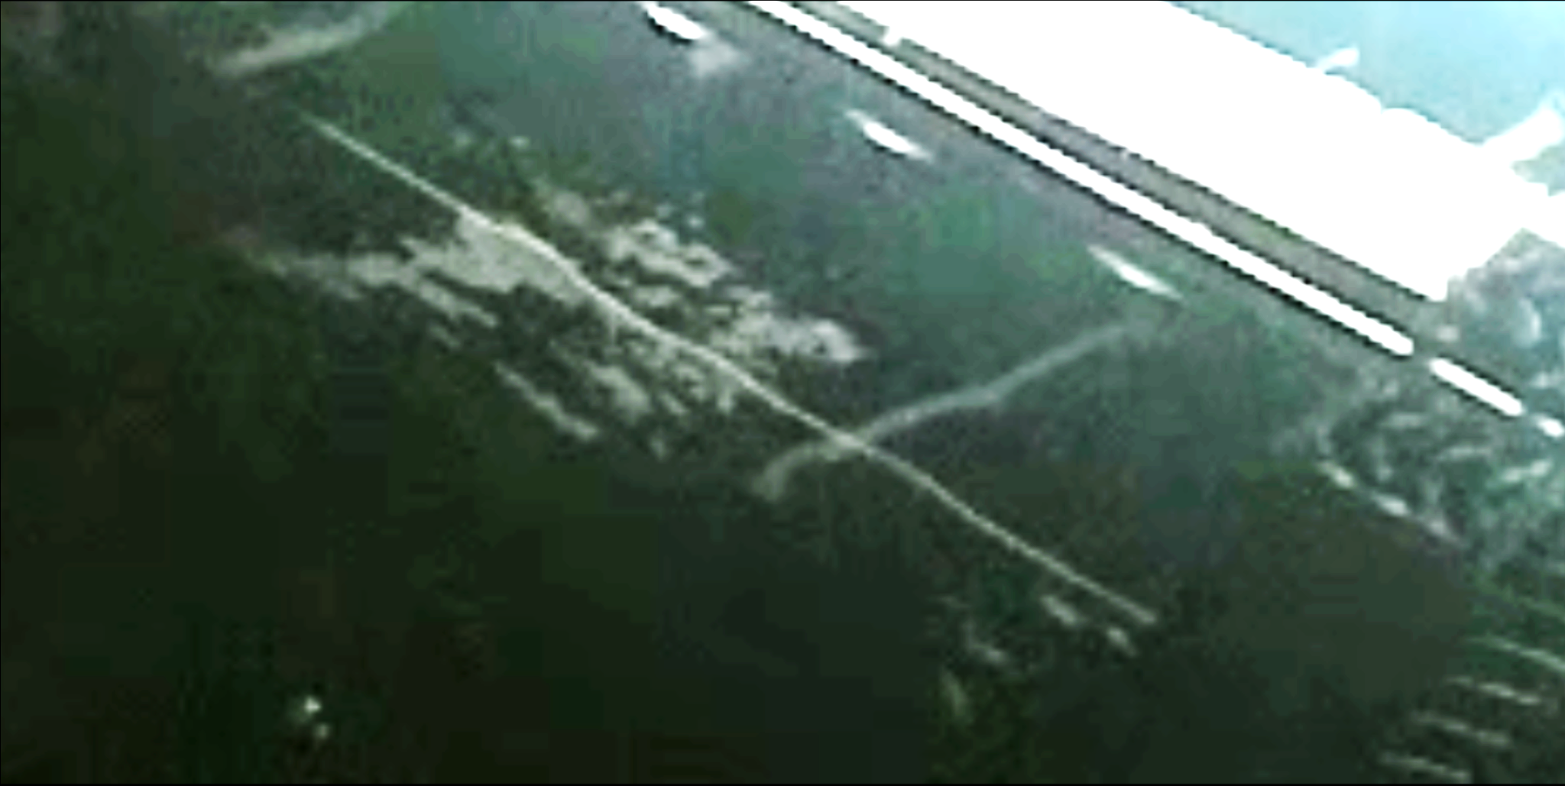
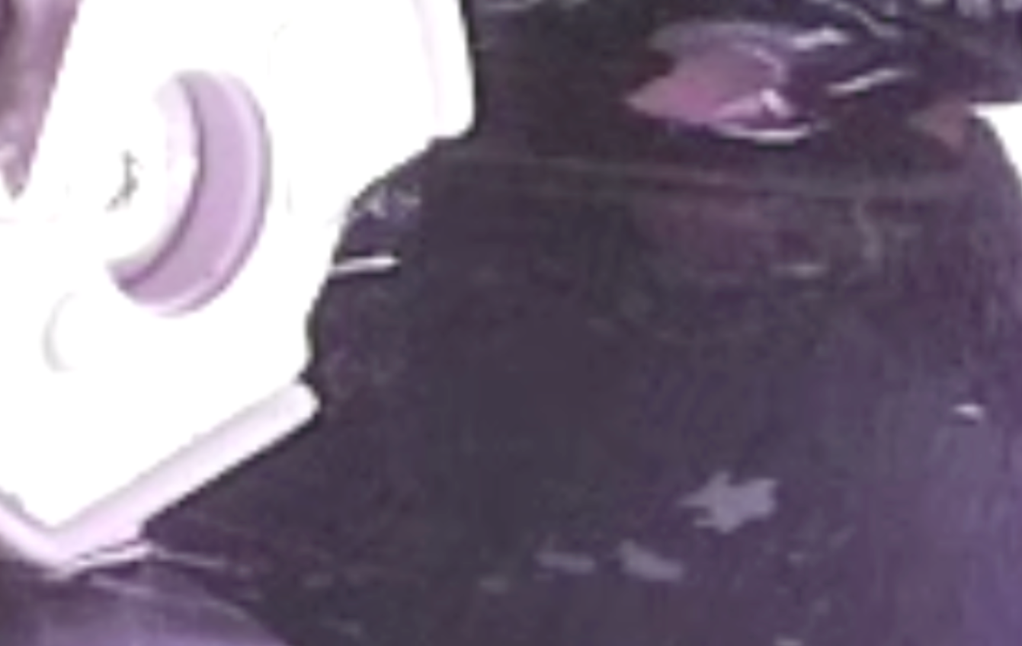
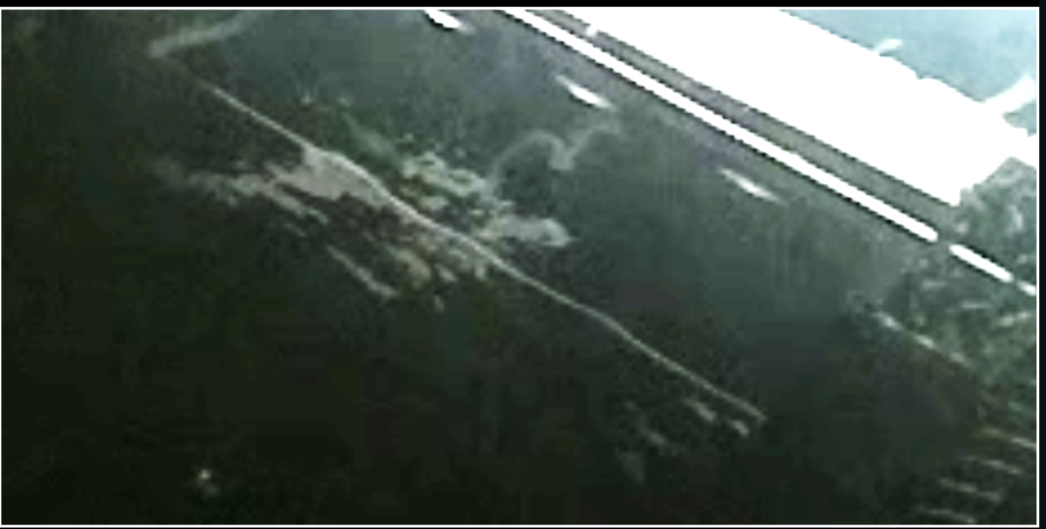
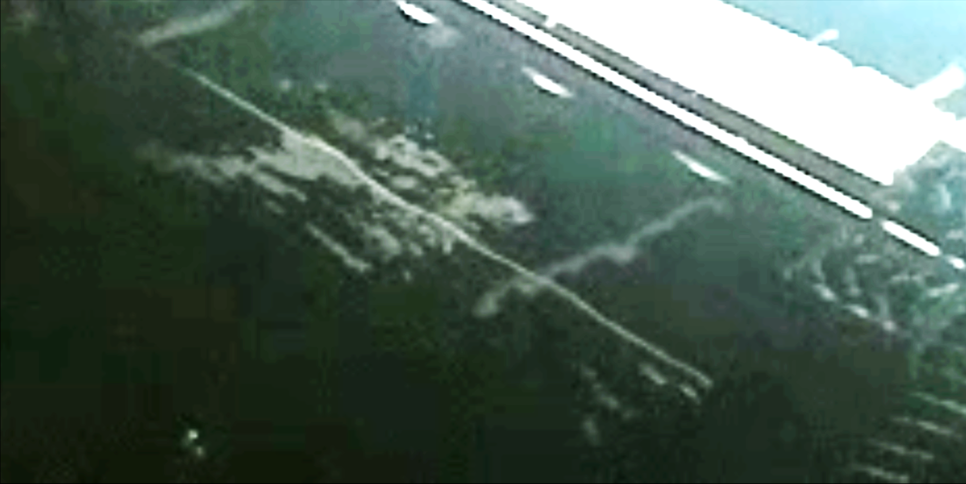
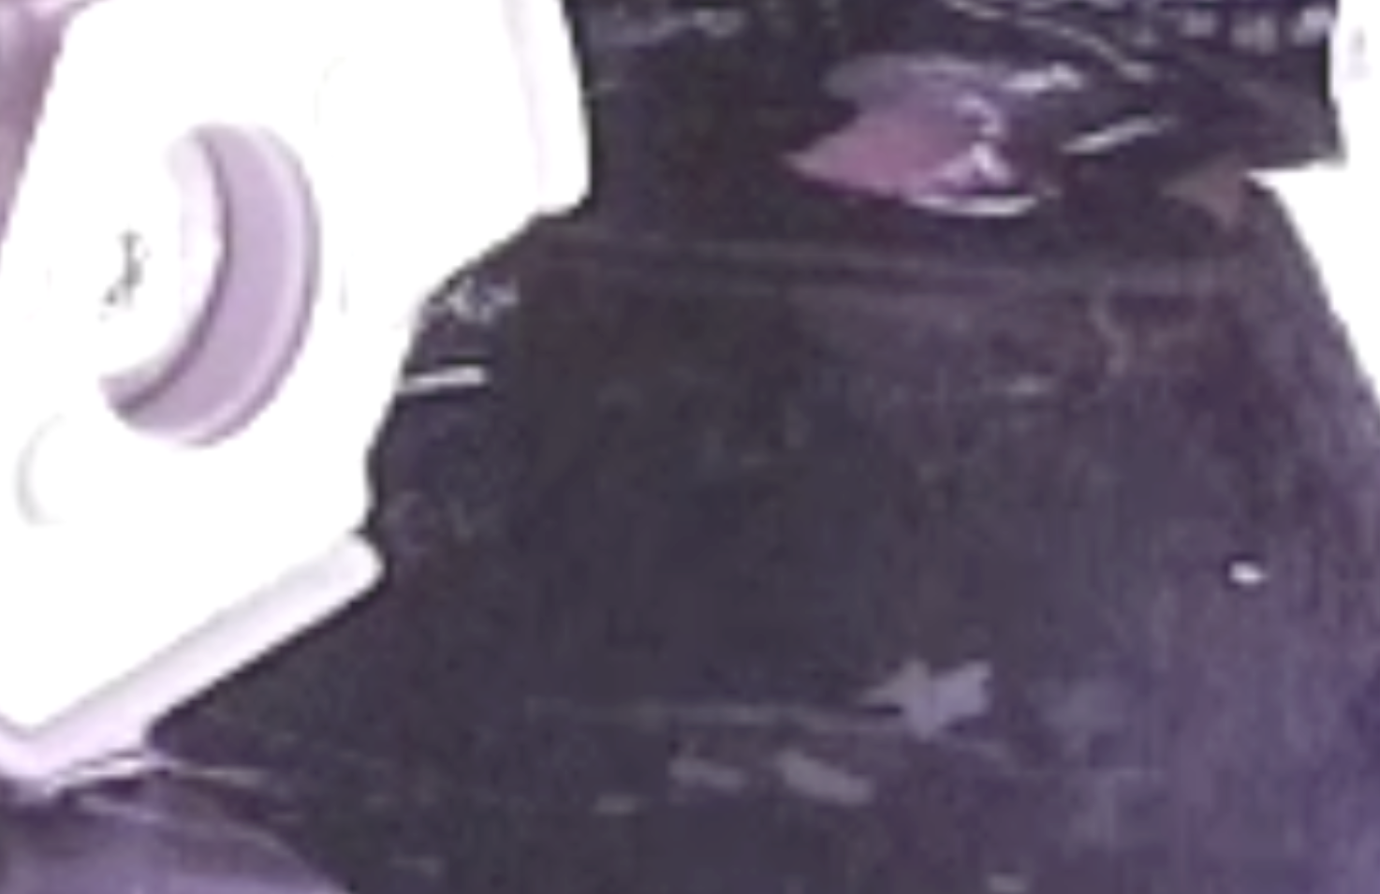
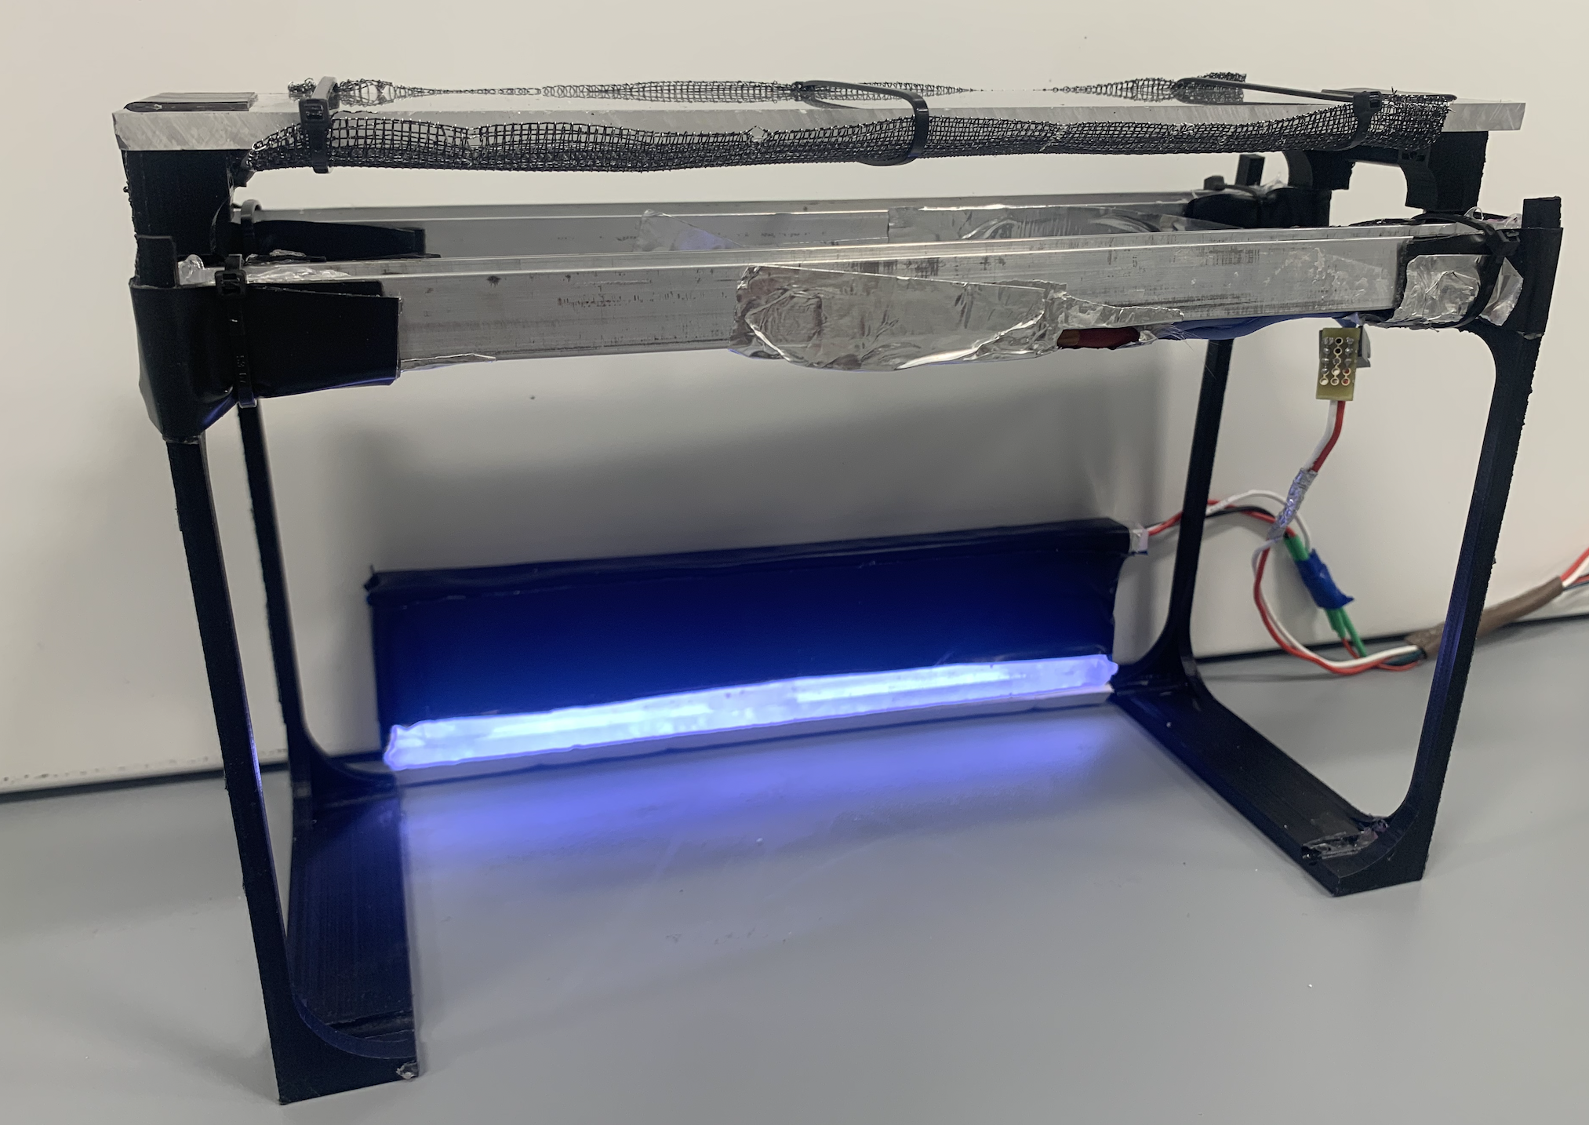
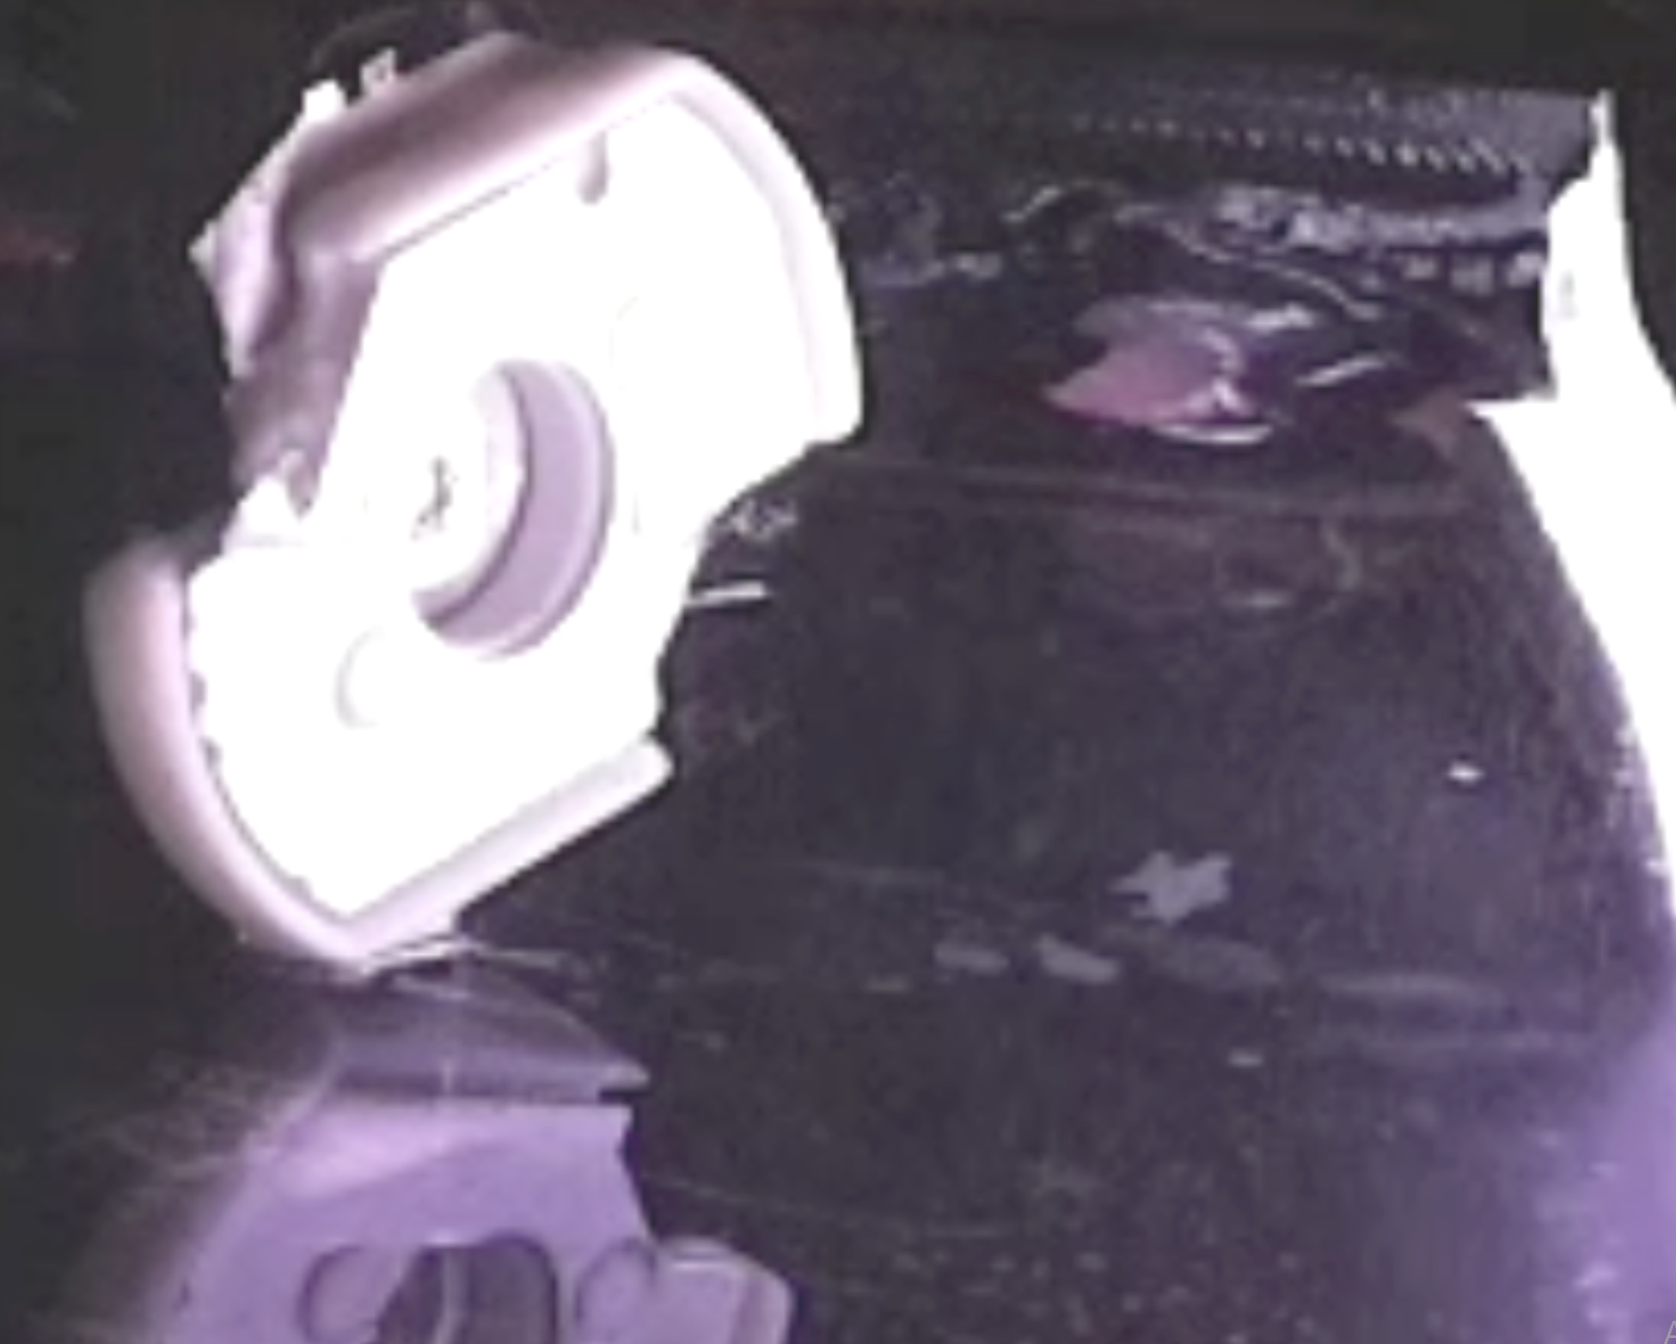
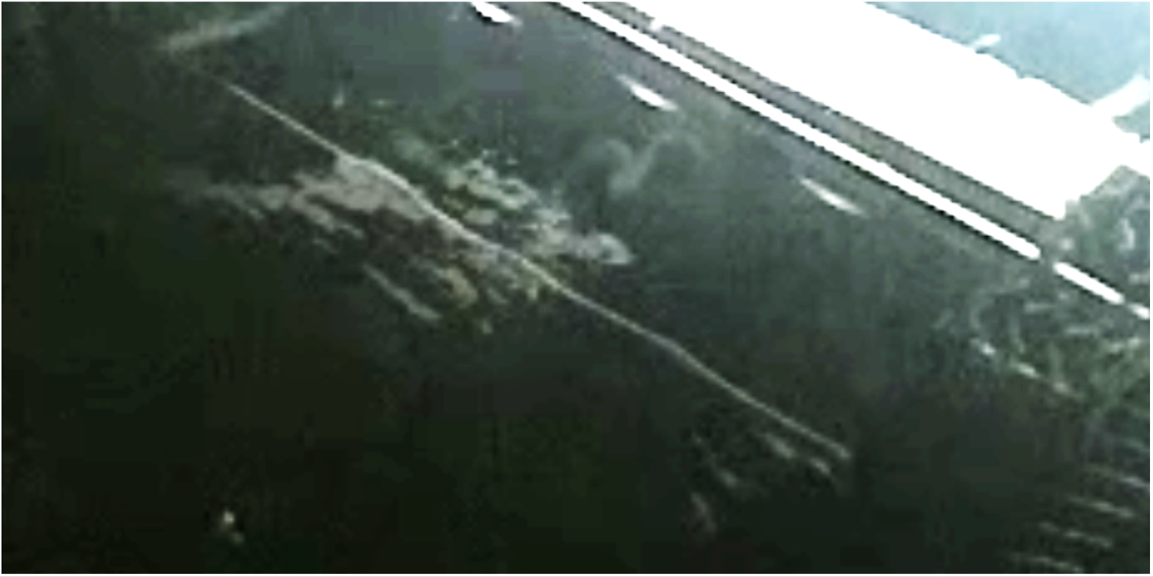
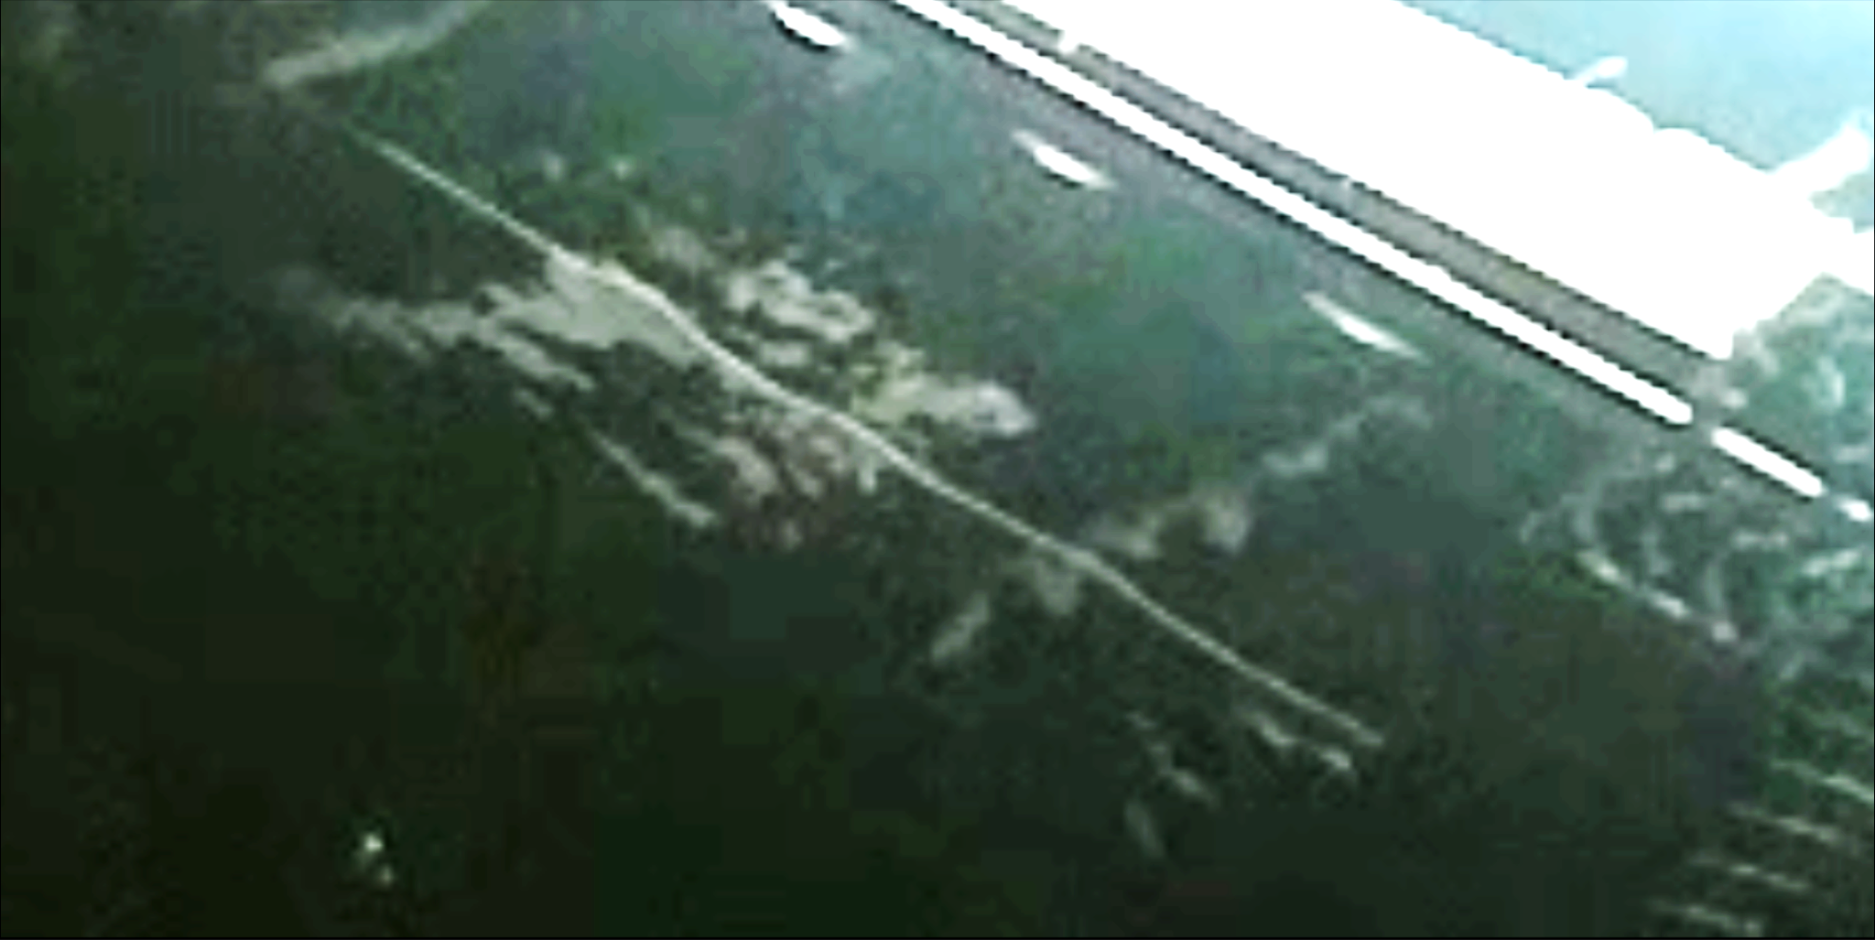
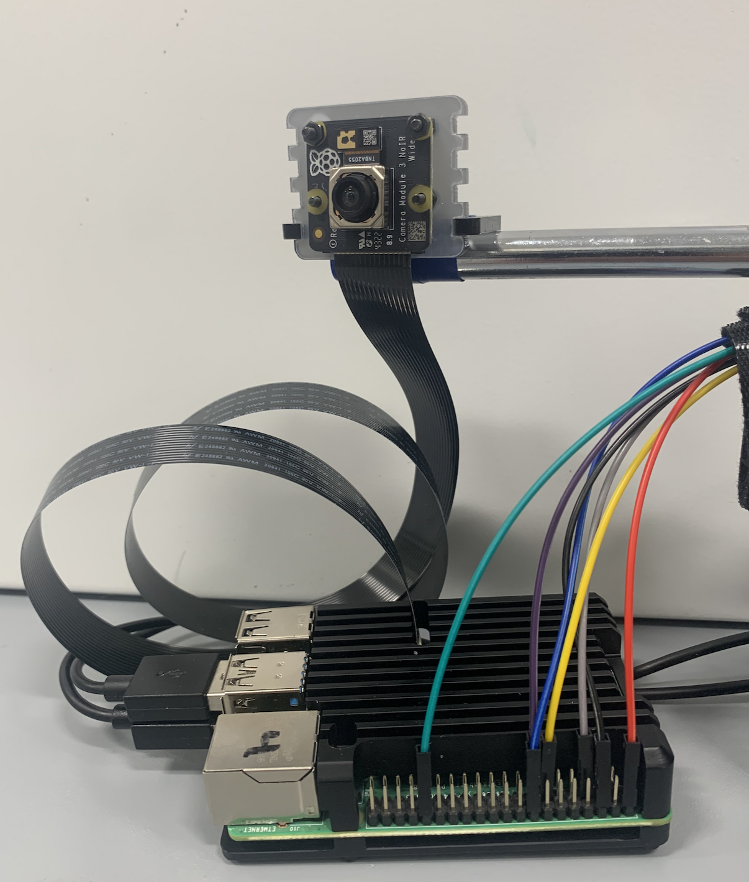
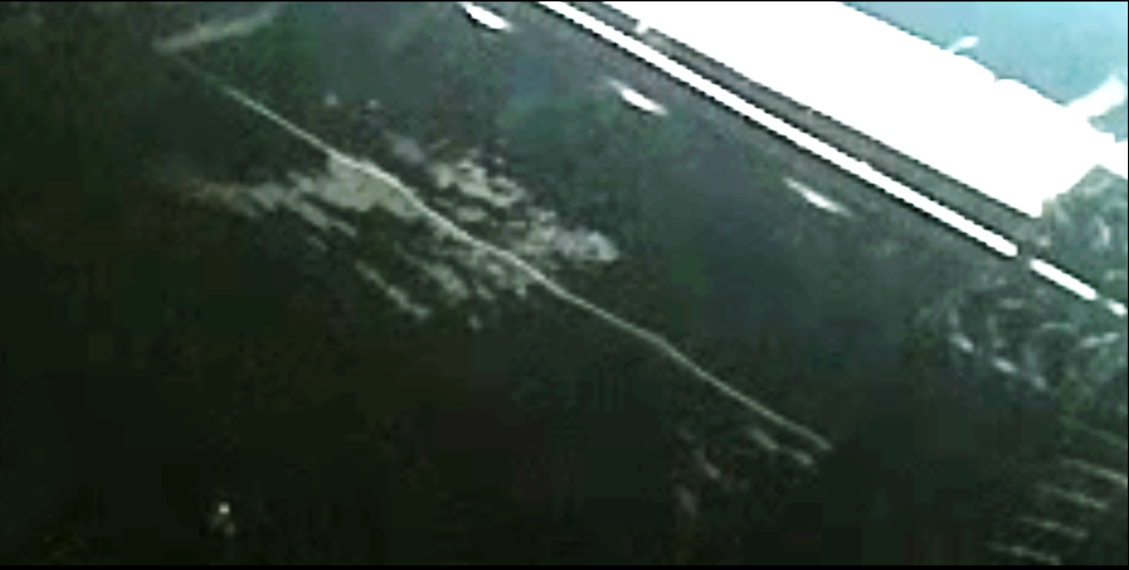
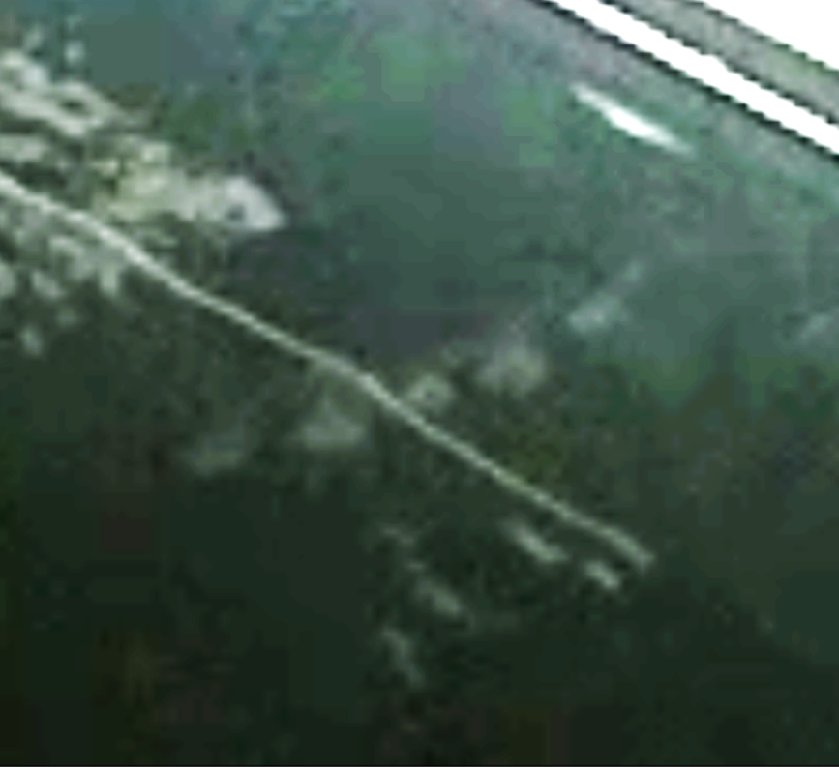

Cloud Chamber Optical Measurement of Nuclear Decay
Khang Kieu and Andrew Liebig, Department of Chemistry and Physics, College of Science and Mathematics
INTRODUCTION
RESULTS
We construct a cloud chamber and perform video analysis to identify and characterize decay phenomena
We optimize conditions to identify ideal system arrangement for imaging decay and measure source disintegrations in the cloud chamber
CONCLUSIONS
We identify characteristic Am-241 and Th-232 alpha decay phenomena that manifest as condensation trails in the vapor
Improved conditions are needed to produce favorable imaging conditions or identify a proportional count rate
1
FUTURE RESEARCH
Fig 1: Am-241 Source
In future research, we plan to:
Construct acrylic or engineered glass chamber enclosure
Integrate and program thermocouple and heating elements
Improve video capture methods to pursue optical counting
Study alternate radioisotope sample sources
We observe Alpha Decay phenomenon in Tungsten Thoriated Rods and Americium.
FIG 2: Th-232 Source
2
8
BACKGROUND
FIG 5: Image series of Th-232 characteristic 4.08 MeV alpha decay shows two charged energetic particles causing ionization and disrupting transport⁴
Cloud Chambers were first developed by Charles Thomson Rees Wilson and applied in experimental analysis in 1912¹
A Cloud Chamber uses temperature gradient in a sealed chamber. The gradient helps create a region of air supersaturated with isopropyl vapor
Radioisotope source disintegrations emit charged particles which transfer energy to the supersaturated vapor²
Decay energy and particle mass produce phase transitions with characteristic condensation vapor trails³
Laterally angled illumination increases visible contrast in decay trails for video analysis³
Particles from atomic disintegrations become visible by unassisted eye
3
9
Fig 7: Possible future projects would study needle sources as calibration to measure activity in natural uranium sources
REFERENCES
¹ Britannica, T. Editors of Encyclopaedia (2023, February 10). C.T.R. Wilson. Encyclopedia Britannica. https://www.britannica.com/biography/C-T-R-Wilson
² Interview of Luis Alvarez by Charles Weiner and Barry Richman on 1967 February 14, Niels Bohr Library & Archives, American Institute of Physics, College Park, MD USA, www.aip.org/history-programs/niels-bohr-library/oral-histories/4483-1
³ B. Allison, Particle physics -cloud chambers activities for
schools (2012), https://www.birmingham.ac.uk.
⁴ National Nuclear Data Center. "NuDat 3.0 database". Brookhaven National Laboratory. https://www.nndc.bnl.gov/nudat3/
EXPERIMENTAL PROCEDURE
4
10
Creating the Temperature Gradient
  Internal electrical heaters increase the temp of an isopropyl alcohol reservoir to 100°C and external ceramic heaters increase surface temp to 85°C
Dry ice cools the steel base plate down to -60°C and condenses alcohol vapor to form droplets
5
11
ACKNOWLEDGEMENTS
We are especially thankful for the support and assistance of the Augusta University Team, especially:
Dr. T. DeSilva for mentorship in theoretical quantum physics,
Dr. T. Colbert for mentorship in experimental methods,
Dr. J.A. Hauger for electronics and micro-computing assistance,
Dr. J. Newton for assistance and mentorship with nuclear theory,
Dr. N. Yanasak for assistance with programming image processing,
Mr. O. Angelton for assistance with laboratory materials, and
Mr. W. Cooke for assistance with system integration.
FIG 3: Voltage Source Screen, Alcohol heater and Lighting assembly
Raspberry Pi 4 controls electronic components
Illumination with programmable LEDs
Power management with programmable relays
High Voltage Generator creates an electric field, increases ionizations and contrast
Imaging with Pi Controlled Camera
Image Processing with MATLAB
FIG 6: Image series of Am-241 characteristic 5.64 MeV alpha decay shows several simultaneous decay tracks
6
12
Am-241 shows a higher rate of ionization, which agrees with the higher isotopic activity as compared to Th-232 (432.6 y for Am-241 and 14x10⁹ y for Th-232) ⁴
Video Media and
Complete Experiment Notes
FIG 4: Camera and Single board computer
7
13

